Slide 1
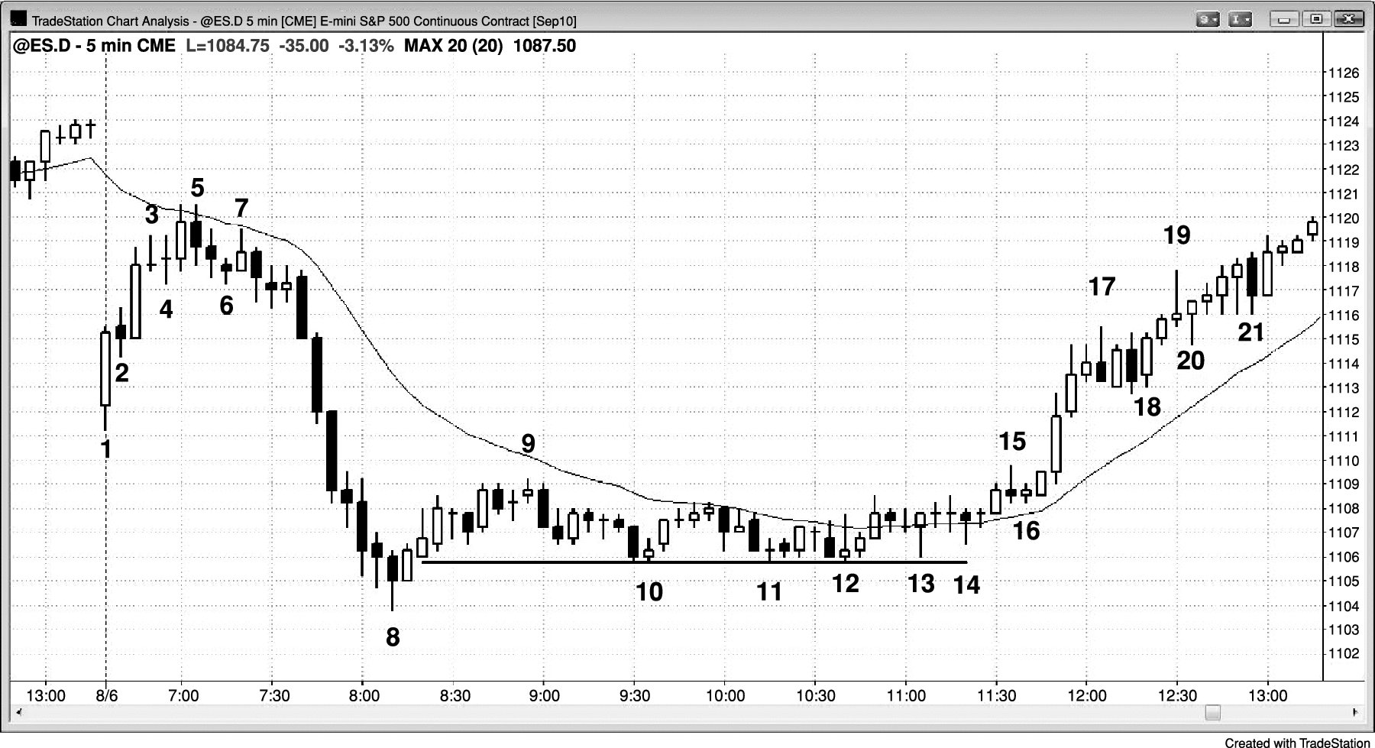
FIGURE 28.1 Limit Order Entries

Slide 2
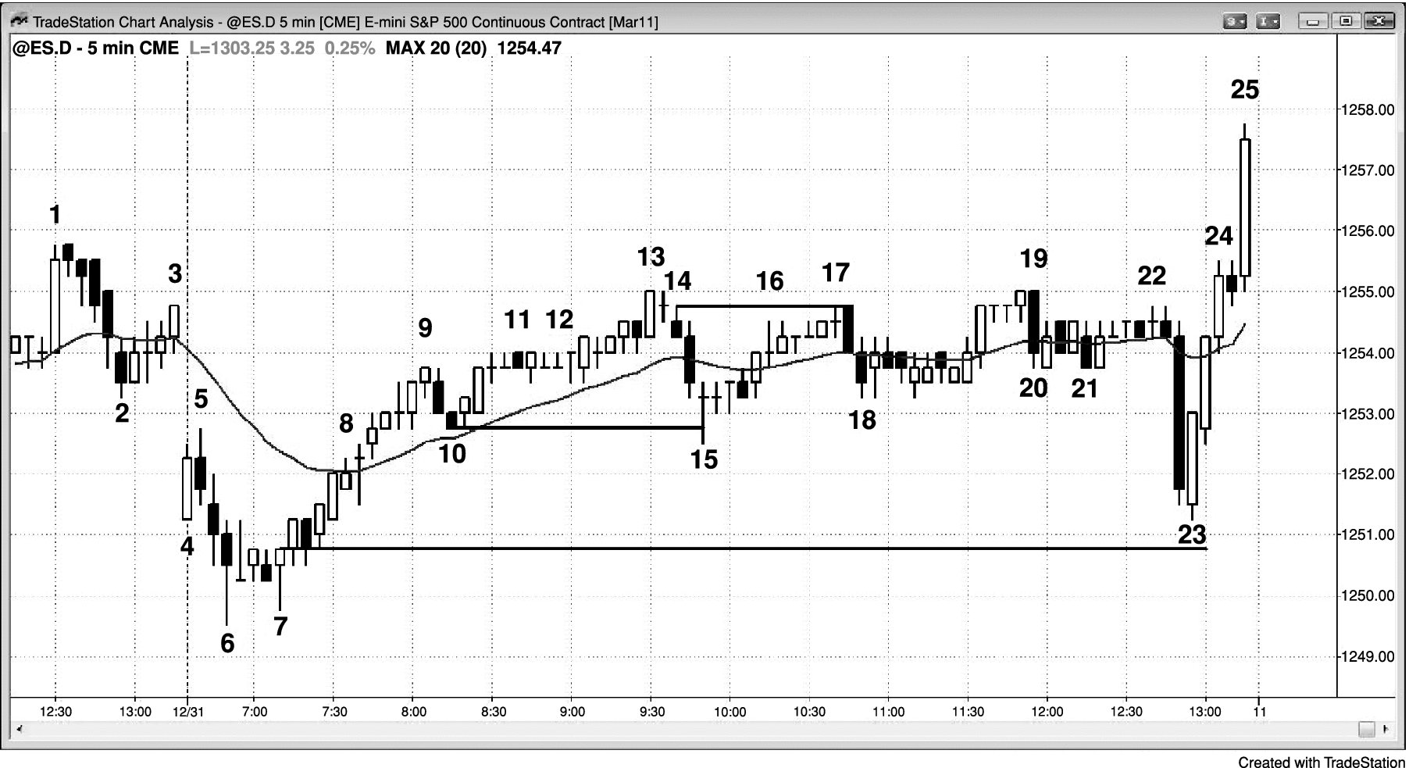
FIGURE 28.2 Limit Order Entries on Quiet Days

Slide 3
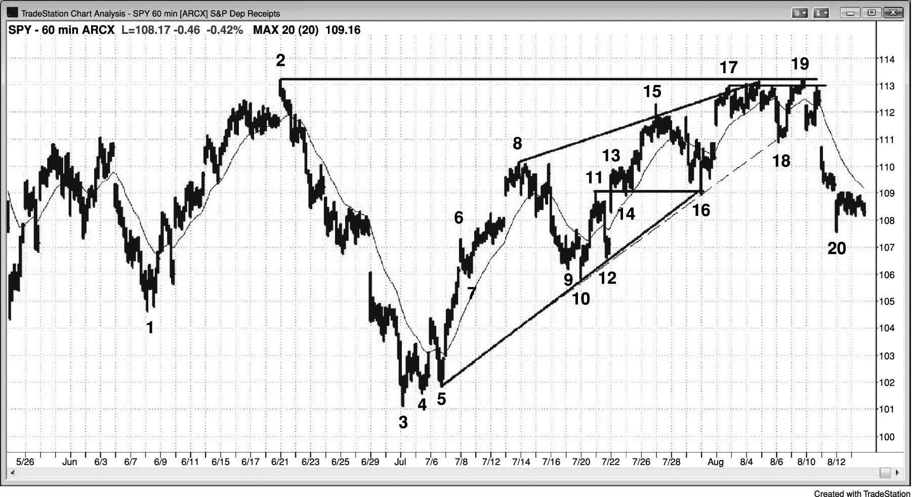
FIGURE 28.3 Limit Order Setups

Slide 4
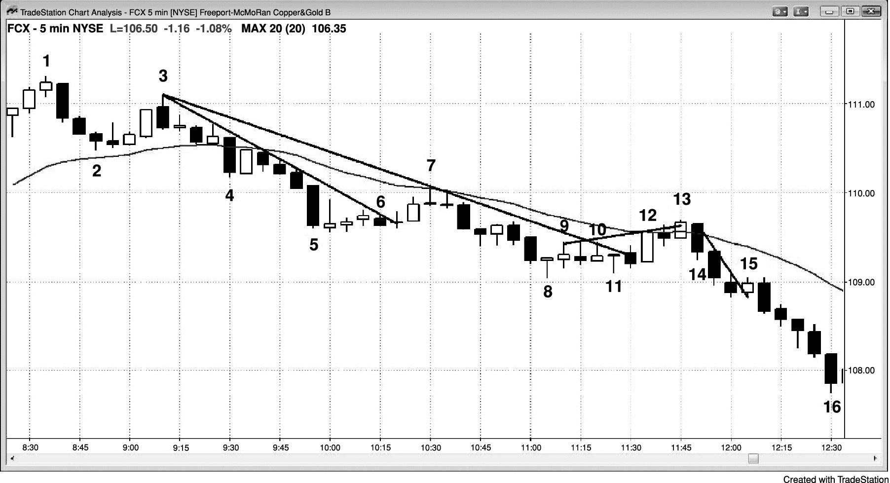
FIGURE 28.4 Fading Tests of Lines with Limit Orders

Slide 5
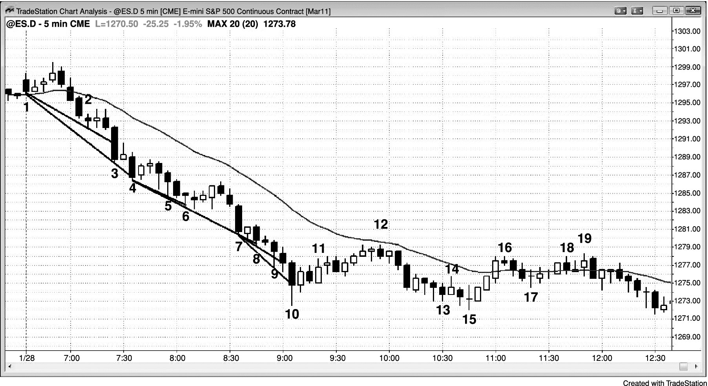
FIGURE 28.5 Trend Channel Lines Trap Early Bulls into Losses in a Strong Bear Trend

